Slide 1



Data Science
Workshop- PUC
01-10-2018

Slide 2



Summary
Data Science Life Cycle;
Exploration Phase;
Production Phase;
Use Cases.
Euler Faria

Slide 3
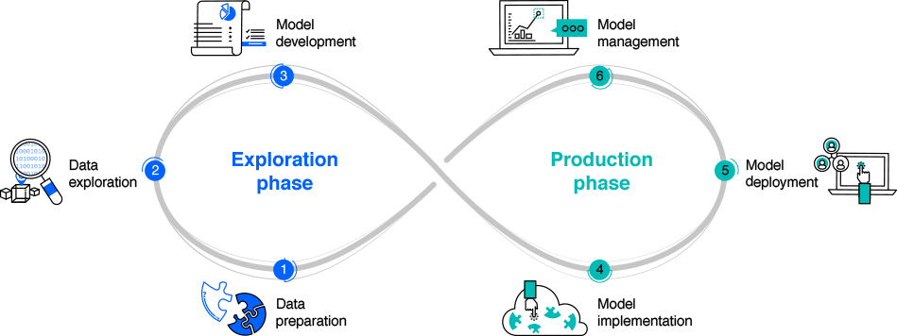
Data Science Life Cycle

Slide 4






Data Preparation
Ask the right business questions ;
Check for data quality;
Collect and prepare the data;
Data wrangling;

Slide 5
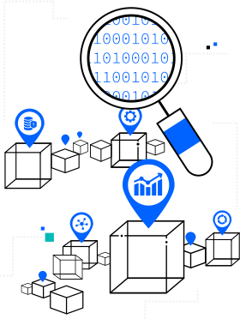




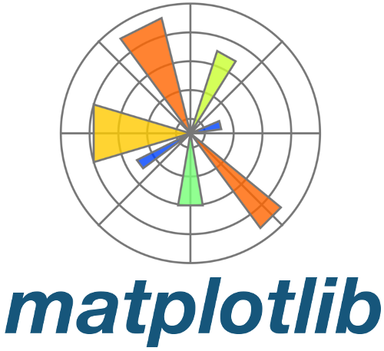

Data Exploration
Which attributes seem promising for further analysis?
Has the exploration revealed new characteristics about the data?
How have these explorations changed any initial hypotheses?
Can a specific subset of the data be used later?
Has the data exploration altered the project goals?
Seaborn
Cognos
Dashboard
Notes:
Illuminate previously unknown patterns;

Slide 6
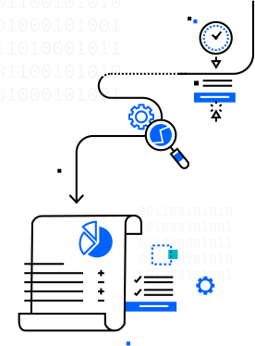







Model Development
Multiple iterations;
One or several models combined;
Models training and optimization;
Model Selection;
Tests of performance.

Slide 7













How IBM Watson Studio can help
Data Refinery;
Built-in charts, statistics and interactive visualizations;
Flexible work space for Business and Technical people;
Open source tools or No-Code visual modeling;
Among all other Watson services:
Visual Recognition
Notes:
Data Refinery : quickly transform large amounts of raw data into consumable, quality information that’s ready for analytics

Slide 8

Model Implementation
Evaluate performance of models;
Evaluate output of models (e.g. tables, graphs);
Simulate the production scenario with business sponsors;
Act upon feedbacks and improve performance;

Slide 9
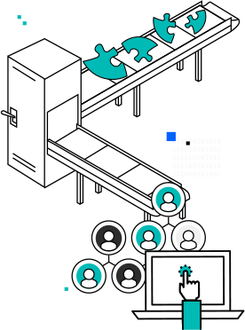
Model deployment
What data does the model expect to ingest and produce?
What infrastructure is required to run this model at scale?
Does the model have everything it needs to execute?
How easy is it to identify points of failure if the model is not running properly?
Notes:
It is usually an IT function;

Slide 10

Model management
Continuous process;
Where each model is in the lifecycle, how old the model is, who developed it, and who is using it for which application.
Model version control;
Continuously gather performance metrics to determine when is need a refresh or replacement;
Notes:
It is usually an IT function;

Slide 11
How IBM Watson Studio can help
Secure environment;
Train models locally, IBM cloud (e.g hybrid, private, public);
Model management dashboard.;
Quickly refresh models with new data
Among all other Watson services:
Visual Recognition
Notes:
Model Management Dashboard: IBM’s Watson Studio enables you to constantly monitor the health and accuracy of your models;

Slide 12

Use cases
Advanced Analytics Team

Slide 13



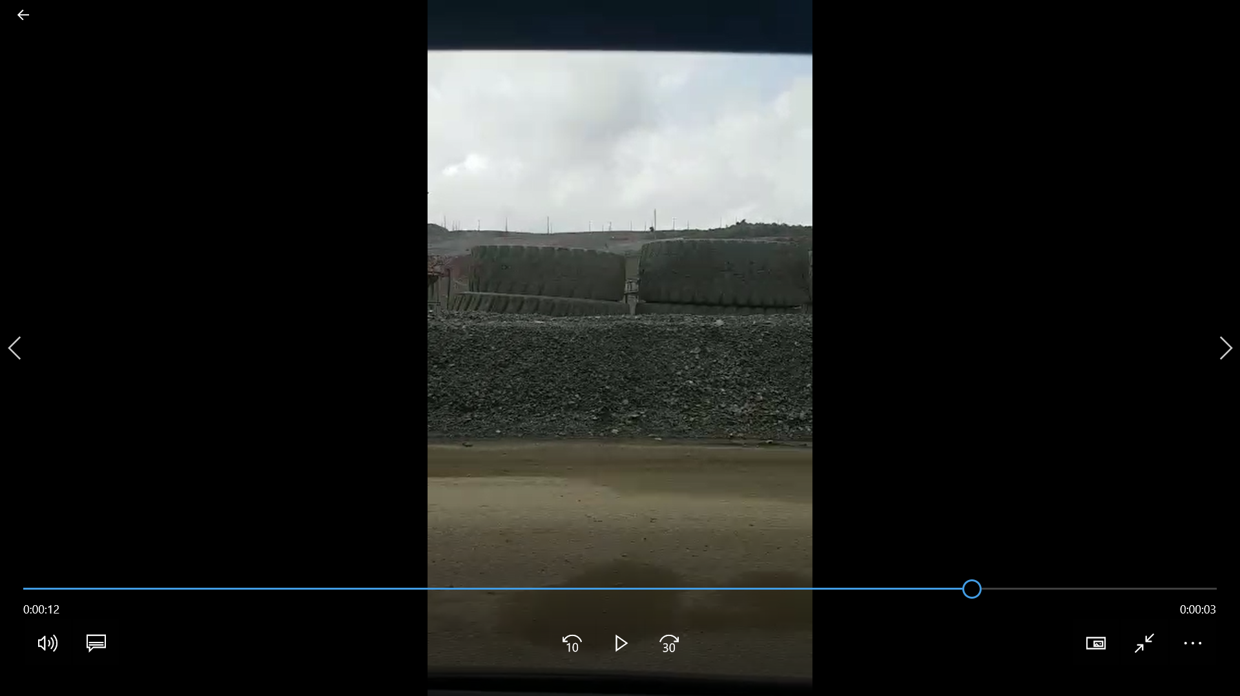





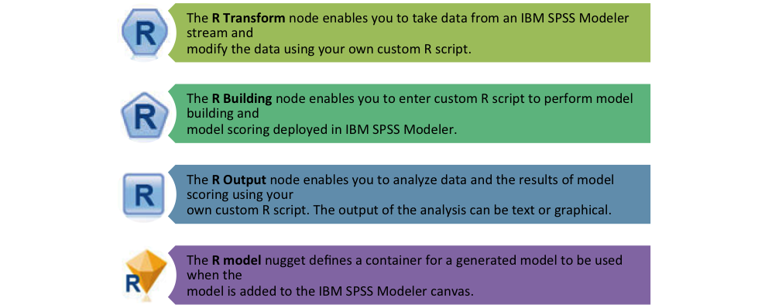

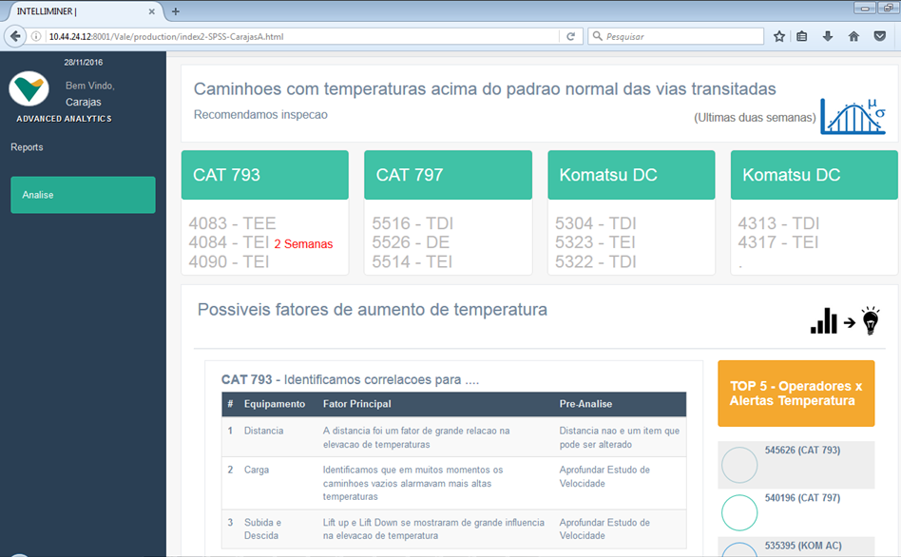
Tires - predictive maintenance
Specialist modeling initiative – Pull-Out Predictive Model
Client: Top 3 global iron ore mining company
IBM Team: Amanda Ferraboli, Maycown Douglas Miranda, Daniel Scalli
Nov/16 - Dec/17
Objective
The Technical Architecture
Data
Sources
Data Treatment &
Modeling
Output
Identification of patterns of alarms that conduct to Pull-Out
Generation of real time analysis of the probability of tires to be subject to pull-out.
Periodic execution of the model to track the evolution of diagnostics and conditions.
Minecare (truck alarms)
Daily component changes (tire tracking)
MEMS (tire alarms)
Identify and predict the main reasons why a tire is prematurely discarded
due to pull-out conditions.
Benefits
Results Examples
Empower the user in terms of efficiency, tracking the probability & causes of damage to consequently mitigate pull-out effects
Stablish maintenance priorities
Avoid non-scheduled stops
Increase the chances of a second life for the tires
Antecipate purchase and supply activities
Dashboard indicating details and model score for each tire in use.
Detailed periodic report indicating most probable variables causing pull-out for each component.
Pull-out alerts integration to user’s maintenance and planning web portal.

Slide 14
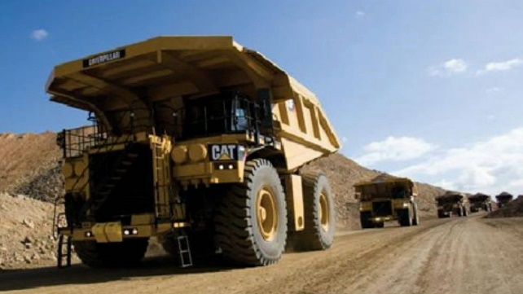
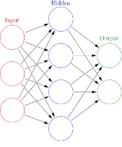


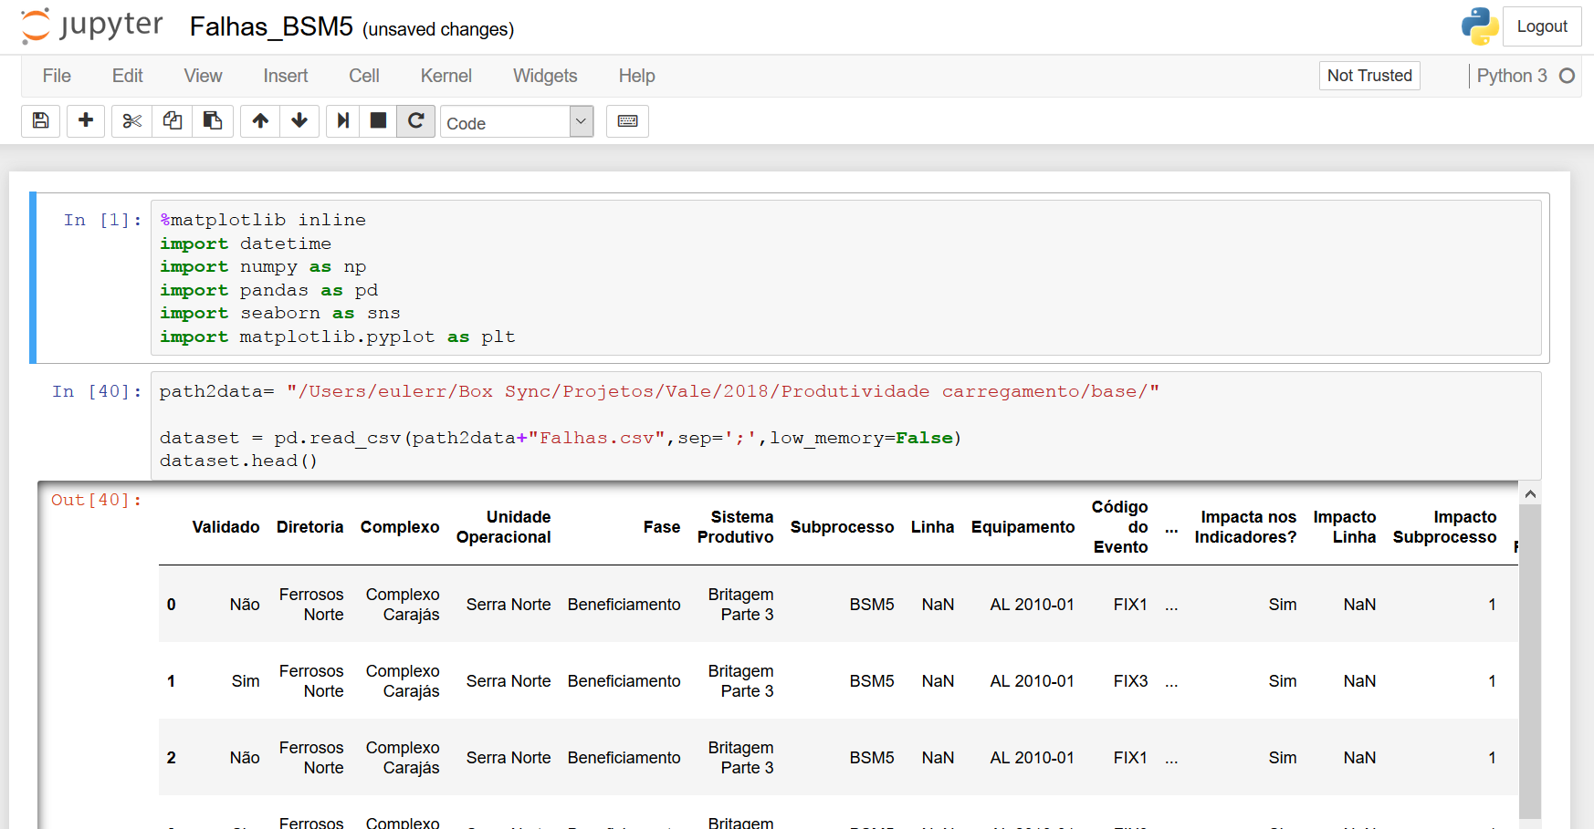
Productivity Mitigation of productivity losses
Client: Top 3 global iron ore mining company
IBM Team: Euler Rodrigues de Sousa Faria, Daniel Scalli
Jul/17 – to date
Objective
The Technical Architecture
Data
Sources
Data Treatment &
Modeling
Output
Anomaly detection: Forecast and explanation of reasons for queue surge events at dumping area.
Production cycle data for every event
Operational sensors
GPV
Predict abnormal behaviors in the production cycle aiming at avoiding productivity rate losses mainly leading to queuing issues.
Results Examples
Benefits
Business understanding and data exploration producing initial descriptive reports and insights
Business workshops
Oráculo: A system able to forecast and explain queue events on open pit mines. The system is being implemented in production.
Mitigate productivity costs derived from queuing
Increase efficiency of operations
Notes:
Technologies & Tools
Python, Jupyter Notebook, SPSS Modeler 18.0, Cluster Analysis, Artificial Neural Networks, Recurrent Neural Networks (LSTM), Embedding, XGBoost.

Slide 15
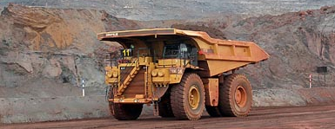
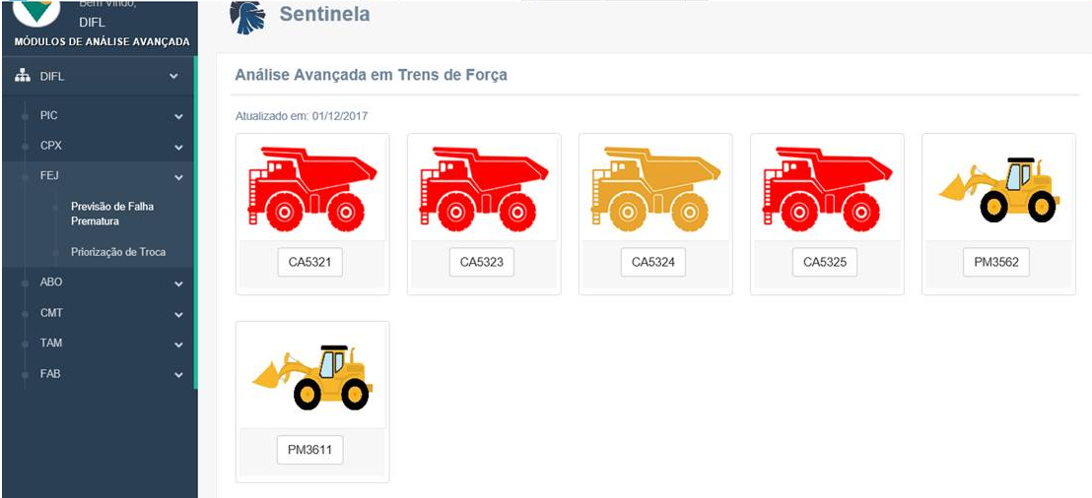
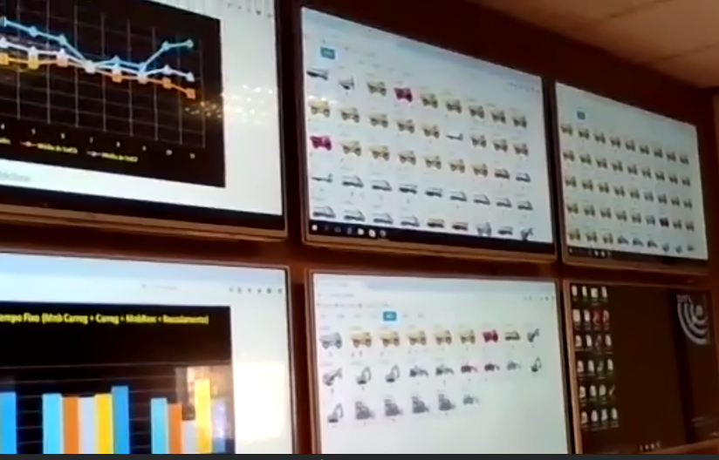
Engines Predictive Maintenance Haul Trucks: Predictive Modeling DIFL
Client: Top 3 global iron ore mining company
IBM Team: Guilherme Rafael Santos, Luis Ricardo Gerbelli
Feb/17 – to date
Objective
The Technical Architecture
Data
Sources
Data Treatment &
Modeling
Output
Oil reports
Fuel
Telemetry SEVA
Maintenance order
User Feedback
Life expectation alerts
Identification of possible problems that cause the expectation to decrease
Prediction of fuel consumption
Prediction modeling for Diesel Engine, Transmission and Final Driver failure and its needs for preventive maintenance in Haul Trucks, Excavators and Track loaders.
Benefits
Results Examples
Extend components lifetime
Avoid truck breakage while in production
Improve purchase planning of engine components
Allow the users to take action before something critical happens
Daily components alerts.
HTML integration to user’s web portal.
Unofficially, the IT team calculates around R$ 10 million saved until now.

Slide 16

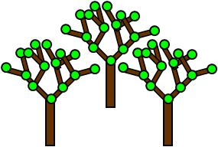

Store location
Client: Leading multinational retailer, one of the largest hypermarket chains in the world
IBM Team: Luis Gerbelli, Leandro Consentino
Mar - May/17
Objective
The Technical Architecture
Model
Inputs
Modeling
Output
Censitary data (social, demographic and economic)
Historical sell out data
Predicted revenue of new store locations with the increment of error (RMSE)
Indication of best regions to open new profitable stores
RANDOM
FOREST
Based on existing stores data, censitary data of the surroundings of these stores and new proposed store locations, predict revenue of potential new stores.
Results Examples
Spatial indication of selected regions in Brazil: areas were populated with censitary and expected revenue data to provide a visual tool for decision making.
Benefits
Robust strategy to determine where to place new stores
Accurate prediction of revenue for the new stores and empowerment of decision makers

Slide 17
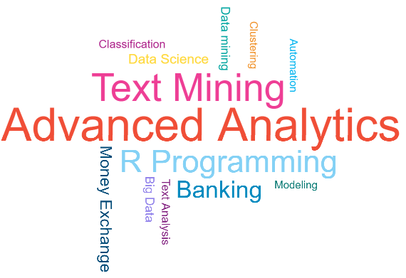
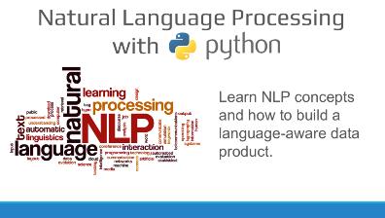
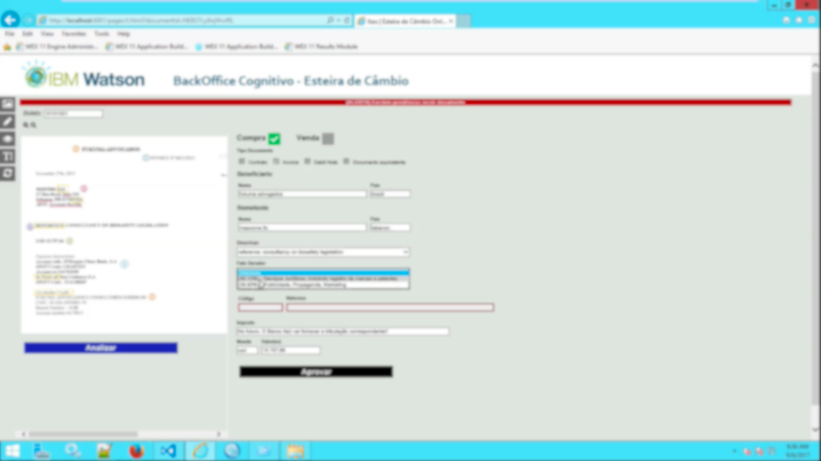
Exchange Transactions: Text-Mining
Client: Major Brazilian banking company
IBM Team: Luis Gerbelli, Isabela Piccinini
Aug/17 – Sept/17
Objective
The Technical Architecture
Model
Inputs
Modeling
Output
Exchange transaction documents
Classification of the exchange transaction types
Automatically classify descriptive texts related to money exchange transactions into predetermined factors (classes)
RANDOM
FOREST
Results Examples
Benefits
Possible exchange transaction classes and their respective probabilities
The user could choose which of the top classes was the document’s class
Reduce human effort;
Speed gain for processing money exchange transactions;
Greater accuracy in classification of money exchange transactions into factors;
Dynamic and adaptive learning to changes over time.

